Slide 1

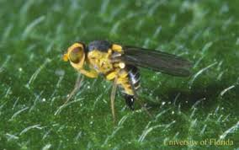
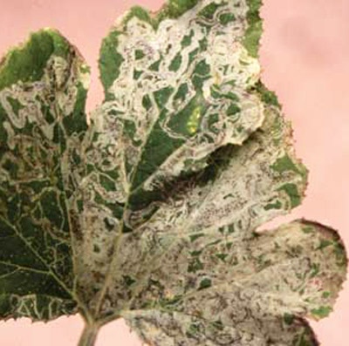
Exotic Pest Fact Sheet
Vegetable leaf miners
(Liriomyza spp.)
What are they?
Vegetable leaf miners( including Liriomyza trifolii, L. strigata, L. sativae, L. huidobrensis and L. pusilla) are small flies whose larvae feed internally on plant tissue, particularly the leaf. Many species of leaf miners are unwanted pests for New Zealand. Feeding of the larvae disrupts photosynthesis and reduces the quality and yield of plants. These pests have a wide host range, including many economically important vegetable, cut flowers, and grain crops.
What do they look like?
The black flies are just visible (1-2.5 mm in length) and often have yellow spots on the head and thorax. Leaf mines caused by larval feeding are usually white with dampened black and dried brown areas. These are typically serpentine or irregular shape, and increase in size as the larvae mature. Damage to the plant is caused in several ways:
• Leaf stippling resulting from females feeding or laying eggs.
• Internal mining of the leaf by the larvae.
• Secondary infection by pathogens that enter the leaf mines or punctures.
• Mechanical transmission of viruses.
What should I look for?
A leaf miner infestation would likely be detected through the presence of the mines in leaf tissue. Adult flies and larvae are unlikely to be seen due to their size.
How does it spread?
Adult flies can spread throughout a crop by flight, but most long distance transport occurs when plant material containing larvae is transported.
Where are they present?
The leaf miners of concern to New Zealand are generally widespread through Africa, America, Europe, Asia and parts of Oceania.
How can I protect my industry?
Check your production site frequently for the presence of new pests and unusual symptoms. Make sure you are familiar with common pests of your production industry so you can recognise something different.
Figure 1. Adult Liriomyza leaf miner. University of Florida.
Figure 2. Mines in squash leaf caused by Liriomyza leaf miners. University of Florida.
If you see any unusual pests or plant symptoms, call the MPI EXOTIC PEST AND DISEASE HOTLINE
0800 80 99 66

