Slide 1

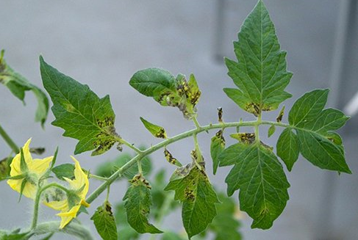
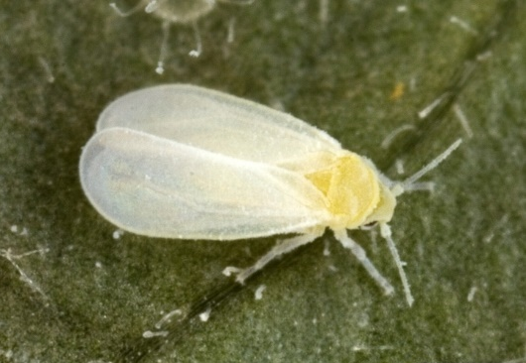
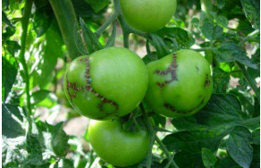
Exotic Pest Fact Sheet Tomato torrado virus (ToTV) family Secoviridae
What is it?
Tomato torrado virus (ToTV) is a disease of greenhouse tomatoes as well as other Solanaceous crops (capsicums and eggplants). Symptoms include leaf discolouration (yellowing) and burn-like lesions on the leaves, as well as stunted plants (Fig. 1). Symptoms can be similar to TSWV (Tomato Spotted Wilt Virus).
How is it transmitted?
ToTV can be transmitted by whiteflies – greenhouse whitefly (Trialeurodes vaporariorum) and whitefly (Bemisia tabaci) (Fig. 2). It can also be spread by trade of infected plants. It is currently thought that ToTV is seed transmitted, based on lab experiments.
What symptoms to look out for?
Affected plants show necrotic (burn-like) lesions in the upper parts of the plants. The burn-like lesions are found at the base of the leaflets (Fig.1). The burns later turn into shot holes (holes in the leaf). Burn-like (necrotic) lesions can also appear lengthwise on the stems, this can be followed by the development of necrotic line patterns or blotches. ToTV can produce deformed fruit making them unmarketable (Fig 3).
Impact
ToTV is an emerging disease of tomato crops. The virus has the potential to cause considerable yield losses and is reportedly causing serious economic losses in tomato crops in Spain.
Where is it present?
Australia (restricted), parts of Europe, South Africa, Mexico and South America.
How can I protect my industry?
Check your production site frequently for the presence of new diseases and unusual symptoms. Make sure you are familiar with common industry diseases so you can recognise something different.
Figure 1. Tomato torrado virus Prof. Dr. Ir. RAA (Rene) van der Vllugt
Figure 2. Vector - greenhouse whitefly (Trialeurodes vaporariorum) adult in-field
David Cappaert, Bugwood.org
Figure 3. Tomato torrado virus – symptoms
on green fruit. Strateco factsheet.
If you see any unusual pests or plant symptoms, call the
MPI EXOTIC PEST AND DISEASE HOTLINE 0800 80 99 66

