Slide 1

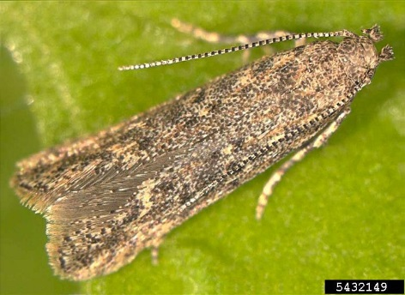
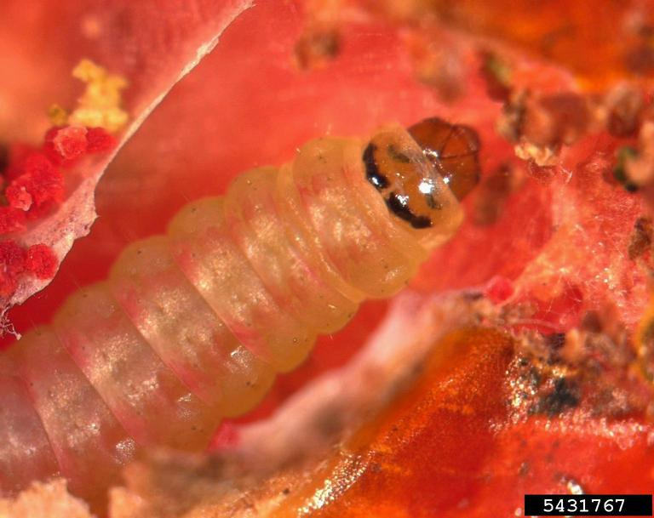
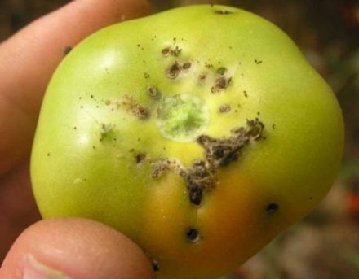
Exotic Pest Fact Sheet Tomato leafminer (Tuta absoluta) Lepidoptera: Gelechiidae
What are they?
Tuta absoluta (tomato leafminer) is a highly destructive leaf mining moth of tomato plants and fruit and can also infest other Solanaceous crops (potato, eggplant).
What do the look like?
Adults are 5-7mm long nocturnal moths, which hide between leaves during the day time (Fig. 1). Females can lay up to 260 eggs which are small white to yellow cylindrical around 0.35 mm long. Larvae are cream coloured with characteristic dark heads (Fig. 2) becoming greenish to light pink in second to fourth instars. An identifying feature of the adult is the bead-like antennae (filiform antennae).
What should I look for?
Tomato leafminers attack the tomato fruit leaving behind exit holes surrounded by dried frass. Other symptoms include mining damage to stems and leaves, abnormal shaped fruit, and rots due to secondary infection.
How does it spread?
Movement of tomato plants, tomatoes (repacking and redistributing infested tomato fruit) and used containers.
Soil is a suspected pathway.
The adult moth is reported to fly up to 100 kilometres so can move between unscreened greenhouses and outdoor crops.
Why is it important?
Most feeding damage is done to the leaves and stems of tomatoes. Larvae feed on new growth, reducing the overall growth and yield of the plant. There are reports of up to 100% losses in tomato crops, and even with controls in place losses can still exceed 5%. Fruit are usually only attacked in heavy infestations, but even a small amount of damage reduces marketability. Secondary rot occurs in the wounds, rendering the fruit unfit for consumption.
Where are they present?
Tomato leafminer is native to Central America and found in Europe, Nigeria and North and South Africa. It is a tropical to subtropical moth, but has infested greenhouses in Northern Europe.
How can I protect my industry?
Check your production site frequently for the presence of new pests and unusual symptoms. Make sure you are familiar with common pests of your industry so you can recognise something different.
Figure 1. Adult tomato leafminer Marja van der Straten, NVWA Plant Protection Service, Bugwood.org
Figure 2. Larvae of tomato leafminer
Marja van der Straten, NVWA Plant Protection Service, Bugwood.org
Figure 3. Tomato leafminer holes with frass
Marja van der Straten, NVWA Plant Protection Service, Bugwood.org
If you see any unusual pests or plant symptoms, call
MPI EXOTIC PEST AND DISEASE HOTLINE 0800 80 99 66

