Slide 1

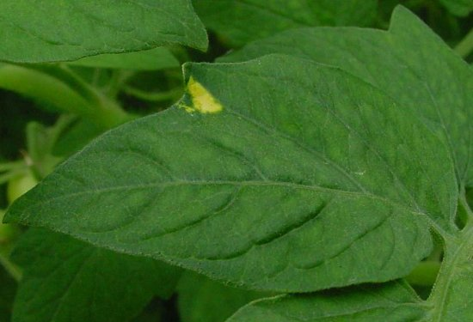
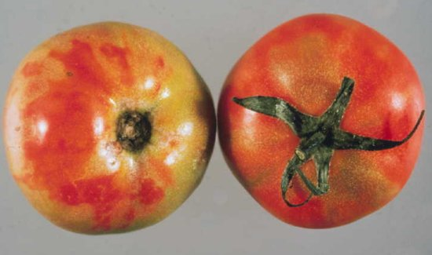
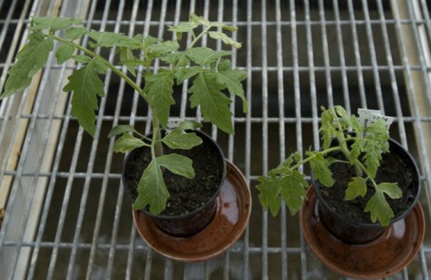
Exotic Pest Fact Sheet
Pepino mosaic virus
(PepMV) family Potexvirus
What is it?
Pepino mosaic virus (PepMV) is a disease of greenhouse tomatoes as well as other Solanaceous crops (capsicums and eggplants).
How is it transmitted?
PepMV is transmitted by contact, including contaminated tools, hands, clothing, direct plant-to-plant contact, and propagation (grafting, cuttings), as well as by seeds. Bees (Bombus spp.) used as pollinators can also spread the virus. It is not thought to be transmitted by aphids.
What symptoms to look out for?
Initial symptoms of PepMV on tomato plants include small yellow leaf spots (Fig 1). Sometimes fruits of infected plants may show an orange mottling but these symptoms can be very inconsistent and may differ between the trusses of one plant (Fig. 2). At a later stage, older leaves may show mottling and top leaves may show slight curling (Fig. 3). Symptoms may depend on climatic conditions and become more visible under (relative) low light conditions.
Impact
PepMV infection does not always result in significant economic impact since fruit symptoms may be absent. It has been suggested that yield may be affected and fruit setting may be delayed. When present it is easily transmitted by contact.
Where is it present?
China (restricted), North, Central and South America and parts of Europe.
How can I protect my industry?
Check your production site frequently for the presence of new diseases and unusual symptoms. Make sure you are familiar with common industry diseases so you can recognise something different.
Figure 1. Pepino mosaic virus,
yellow leaf spot symptom
Image from DPV411 Fig. 4
Figure 2. Tomato fruit symptoms showing uneven ripening and surface 'marbling‘ (left), healthy with normal appearance (right). Image from DPV411 Fig. 6
If you see any unusual pests or plant symptoms, call the
MPI EXOTIC PEST AND DISEASE HOTLINE 0800 80 99 66
Figure 3. Infected plant on right showing
slight leaf discolouration.
Image from DPV411 Fig.13

