Slide 1

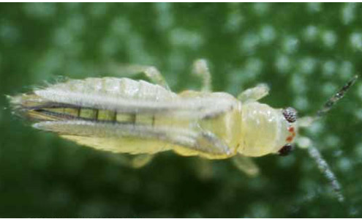
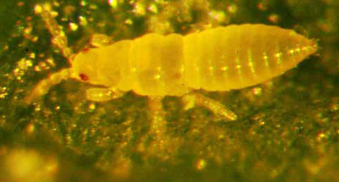
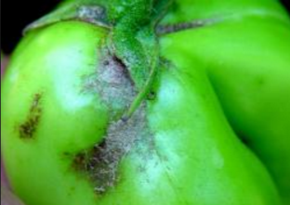
Exotic Pest Fact Sheet
Chilli thrips
(Scirtothrips dorsalis)
What are they?
Chilli thrips (Scirtothrips dorsalis) are extremely small insects (2mm) that often go undetected. They feed on more than 100 plants from around 40 different families including tomatoes and other Solanaceous crops (capsicum, eggplants).
What do the look like?
Adults are around 2 mm, pale with dark wings. Immatures are also pale in colour and are without wings. The chilli thrips resembles many other thrips species.
What should I look for?
Chilli thrips feed on the lower surface of leaves, buds, flowers and fruits. Both larvae and adults feed by piercing the plant tissue and sucking up the released plant juices. A heavy infestation causes premature wilting, delay in leaf development and distortion of leaves and young shoots. Under heavy infestations, the buds and flowers usually die. Chilli thrips infestation may also result in premature fruit fall or can damage the fruit. They can also vector diseases.
How does it spread?
Chilli thrips are dispersed via infested plant material – cut flowers, fruits and vegetables. Wind currents may also contribute in the dispersal of adult thrips.
Where are they present?
Chilli thrips are widespread and are considered present in many Asian countries, Africa, America, United Kingdom, Australia, Papua New Guinea (native), Solomon Islands (native).
How can I protect my industry?
Check your production site frequently for the presence of new pests and unusual symptoms. Make sure you are familiar with common pests of your industry so you can recognise something different.
Figure 1. Male chilli thrips
Lance Osborne – University of Florida
Figure 2. Larvae of chilli thrips
Vivek Kumar – University of Florida
If you see any unusual pests or plant symptoms, call the
MPI EXOTIC PEST AND DISEASE HOTLINE 0800 80 99 66
Figure 3. Thrips damage on tomato
Infonet-biovision

